Slide 1
Quick sort

Slide 2
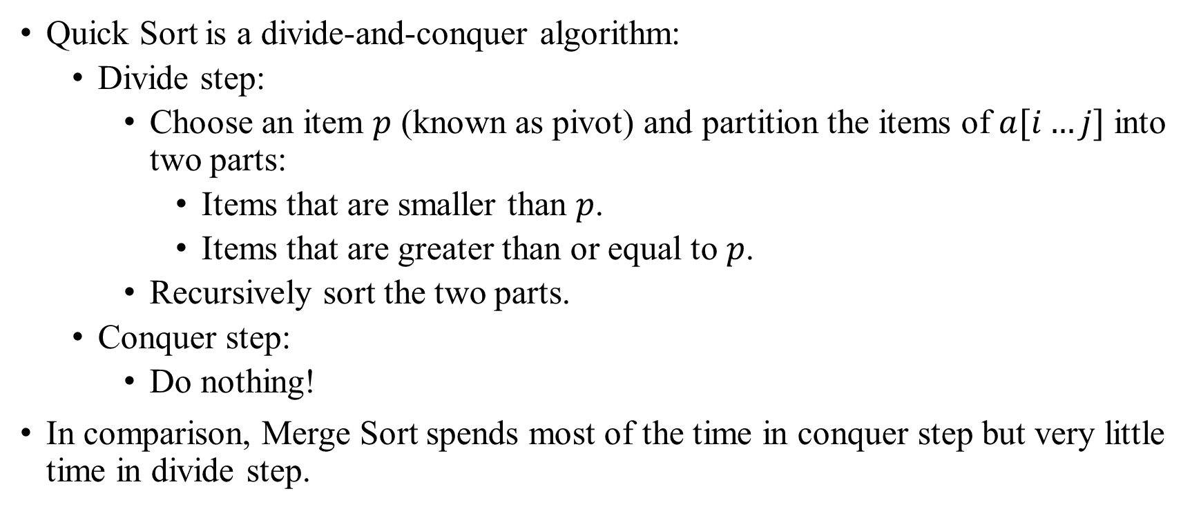
Quick Sort
Idea

Slide 3
Quick Sort
Divide Step Example
Pivot
Choose first element as pivot
27 | 38 | 12 | 39 | 27 | 16
Pivot
Partition arr about the pivot 27
12 | 16
27
39 | 27 | 38
Pivot
Recursively sort the two parts
12 | 16 | 27 | 27 | 38 | 39
Notice anything special about the position of pivot in the final sorted items?

Slide 4
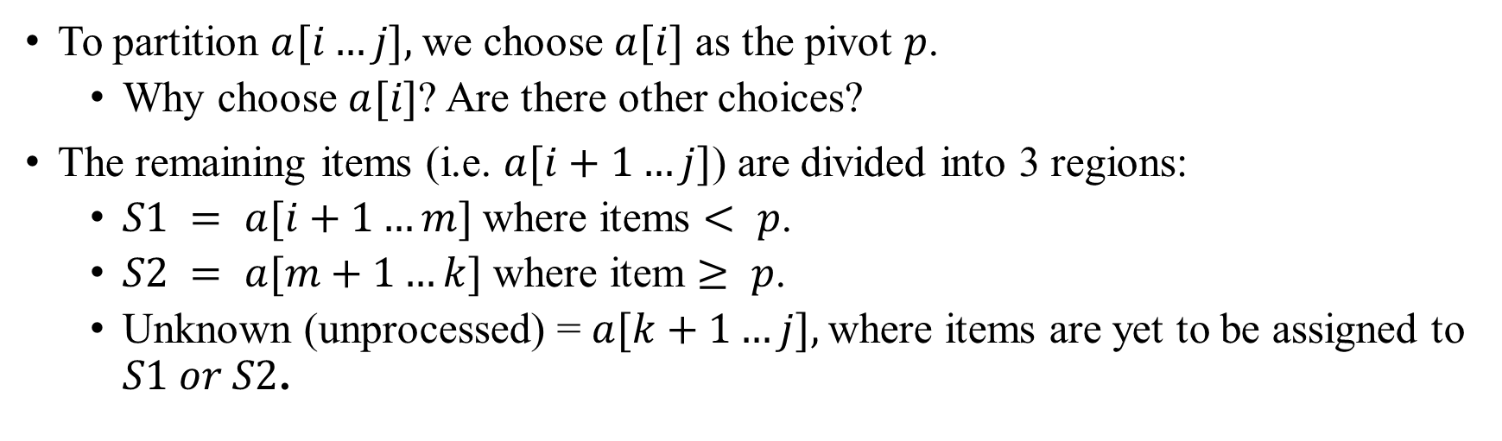
Quick Sort
Partition Algorithm
i
m
k
j
p | <p | ≥p | ?
S1
S2
Unknown

Slide 5
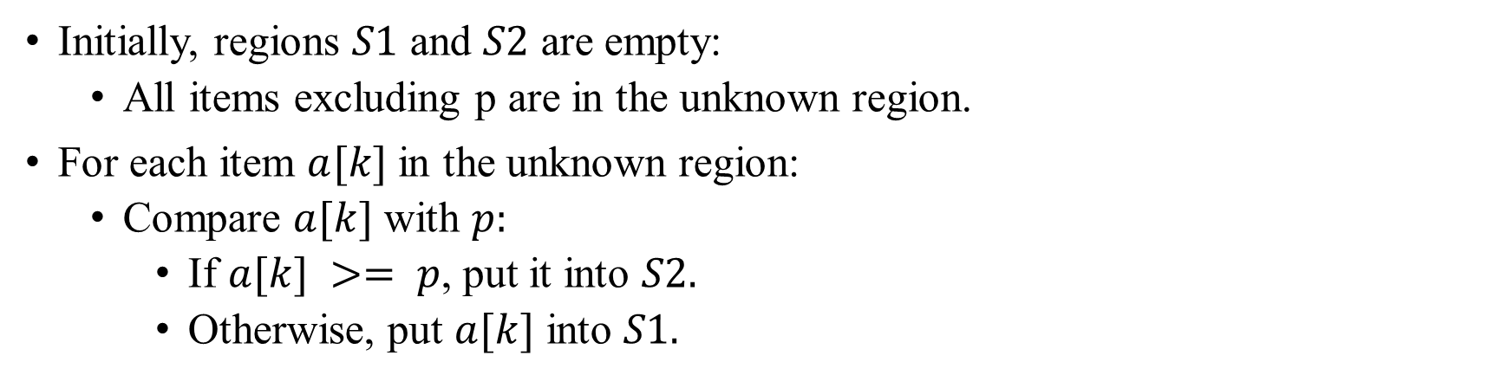
Quick Sort
Partition Algorithm
i
k
j
p | ?
Unknown

Slide 6
Quick Sort
Partition Algorithm
Case 1: if a[k] >= p:
S1
S2
If a[k]=y >= p:
p | < p | x | ≥ p | y | ?
i
m
k
j
S1
S2
Increment k:
p | < p | x | ≥ p | y | ?
i
m
k
j

Slide 7
Quick Sort
Partition Algorithm
Case 2: if a[k] < p
S1
S2
If a[k]=y < p:
p | < p | x | ≥ p | y | ?
i
m
k
j

Slide 8
Quick Sort
Partition Algorithm
Case 2: if a[k] < p
S1
S2
Increment m:
p | < p | x | ≥ p | y | ?
i
m
k
j

Slide 9
Quick Sort
Partition Algorithm
Case 2: if a[k] < p
S1
S2
Swap x and y:
p | < p | y | ≥ p | x | ?
i
m
k
j

Slide 10
Quick Sort
Partition Algorithm
Case 2: if a[k] < p
S1
S2
Increment k:
p | < p | y | ≥ p | x | ?
i
m
k
j

Slide 11
Quick Sort
Partition Example
Pivot
Unknown
27 | 38 | 12 | 39 | 27 | 16
We take as pivot first element, and compare is with first element from Unknown section.

Slide 12
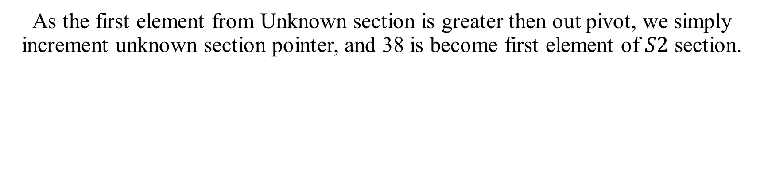
Quick Sort
Partition Example
Pivot
S₂
Unknown
27 | 38 | 12 | 39 | 27 | 16

Slide 13
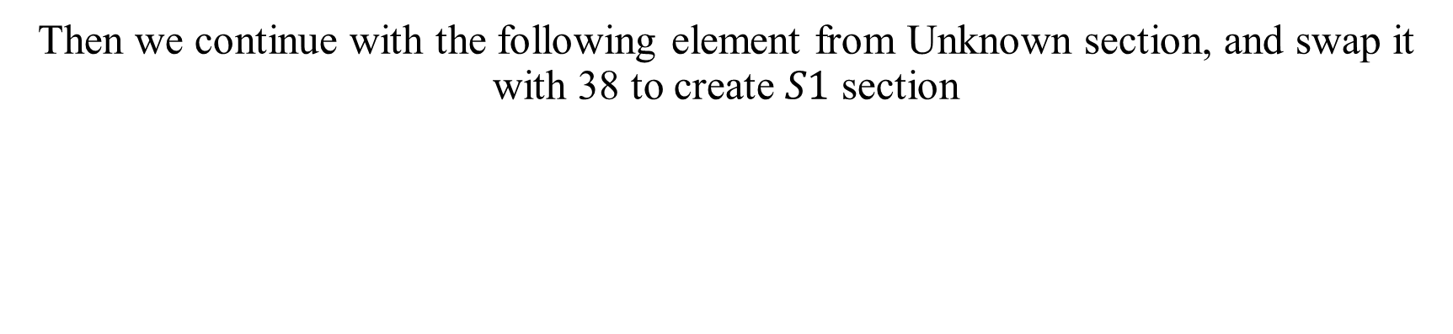
Quick Sort
Partition Example
Pivot
S₂
Unknown
27 | 38 | 12 | 39 | 27 | 16

Slide 14
Quick Sort
Partition Example
Pivot
S₁
S₂
Unknown
27 | 12 | 38 | 39 | 27 | 16

Slide 15
Quick Sort
Partition Example
Pivot
S₁
S₂
Unknown
27 | 12 | 38 | 39 | 27 | 16
Now we take the first element from Unknown section again, and increment S2 section.

Slide 16
Quick Sort
Partition Example
Pivot
S₁
S₂
Unknown
27 | 12 | 38 | 39 | 27 | 16
Now we take the first element from Unknown section again, and increment S2 section.

Slide 17
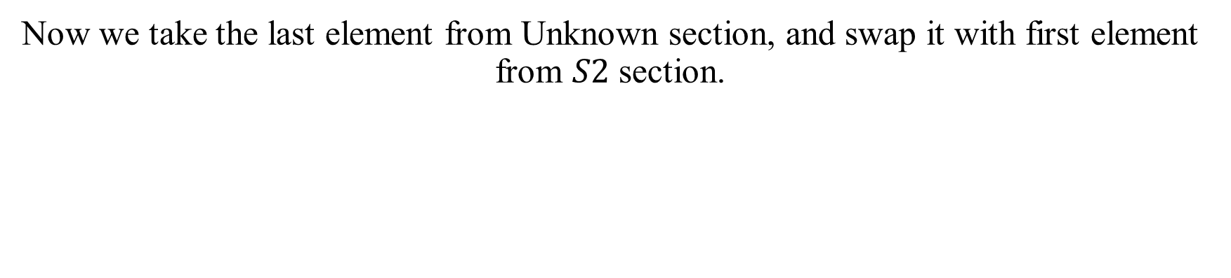
Quick Sort
Partition Example
Pivot
S₁
S₂
Unknown
27 | 12 | 38 | 39 | 27 | 16

Slide 18
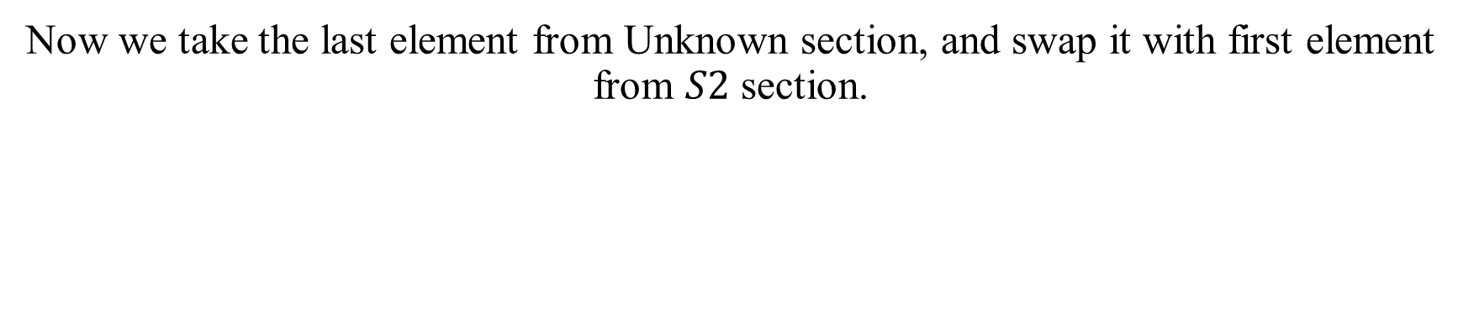
Quick Sort
Partition Example
Pivot
S₁
S₂
27 | 12 | 16 | 39 | 27 | 38

Slide 19
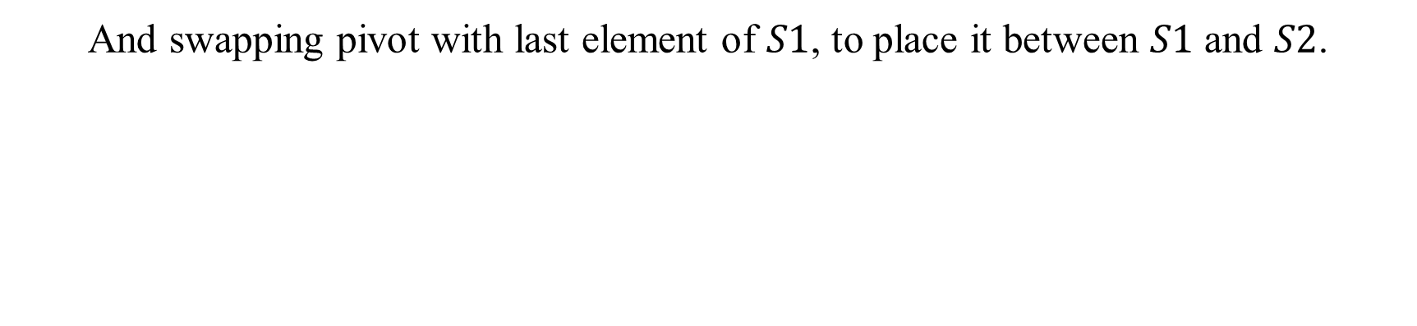
Quick Sort
Partition Example
S₁
Pivot
S₂
16 | 12 | 27 | 39 | 27 | 38

Slide 20
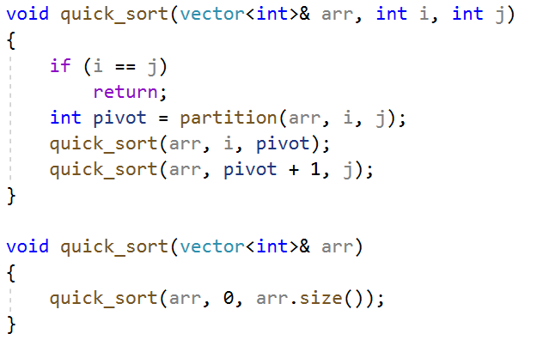
Quick Sort
Implementation

Slide 21
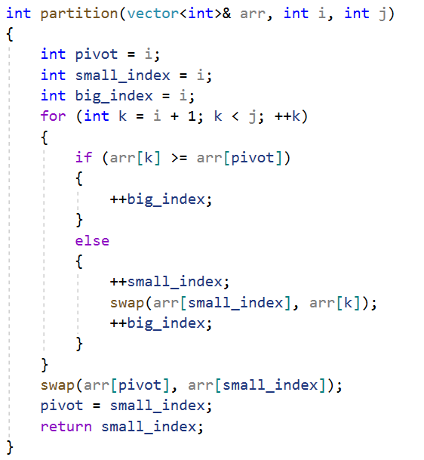
Quick Sort
Partition implementation

Slide 22
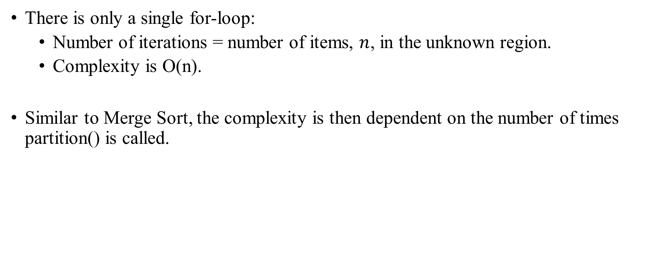
Quick Sort
Partition Analysis

Slide 23
Quick Sort
Worst Case Analysis
When the array is already in ascending order
S1 is empty, while S2 contains every item except the pivot
5 | 18 | 23 | 39 | 44 | 57
p = a[i]
S2 = a[m+1...j]
S1 = a[i+1...m] empty when m = i

Slide 24
Quick Sort
Analysis
n
1
n-1
As each partition takes linear time, the algorithm in its worst case has n levels and hence it takes time n+(n-1)+…+ = O(n²)
Total no. of levels = n
1
n-2
…
1
1
Contains the pivot only!

Slide 25
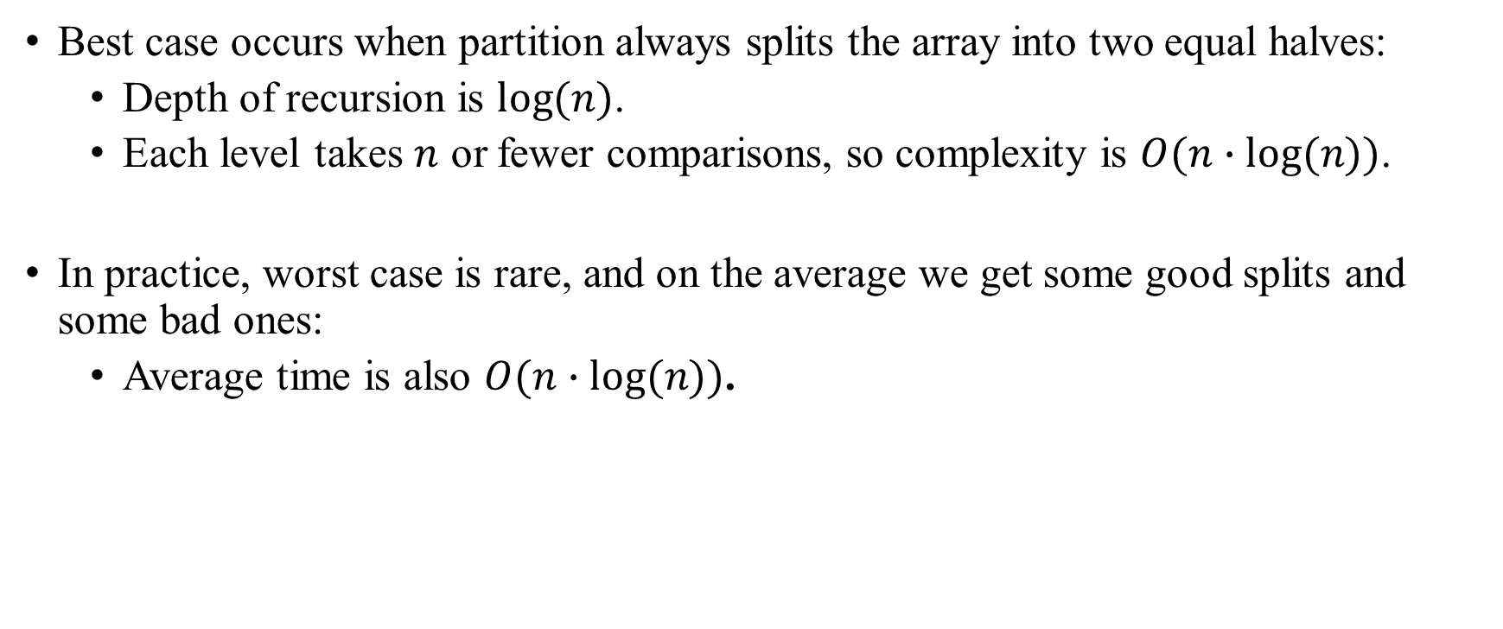
Quick Sort
Best/Average Case Analysis

